Slide 1
Ecological and epidemiological inference from evolutionary trees
Justin Bahl

Slide 2
Evolutionary processes give rise to diversity
There are four basic mechanisms by which biological evolution takes place. These include mutation, migration, genetic drift, and natural selection.

Slide 3
Evolutionary processes give rise to diversity
There are four basic mechanisms by which biological evolution takes place. These include mutation, migration, genetic drift, and natural selection.
When we sequence a population of viruses we are observing genetic diversity resulting from those processes

Slide 4
Wikipedia
A phylogenetic tree or evolutionary tree is a branching diagram or "tree" showing the inferred evolutionary relationships among various biological species or other entities based upon similarities and differences in their physical and/or genetic characteristics.

Slide 5
A phylogenetic tree is
is an evolutionary hypothesis showing the history and relationships (common descent) of the observed (genetic) diversity

Slide 6
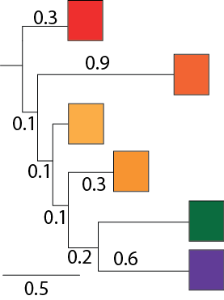
Dimensions

Slide 7
Dimensions
Vertical dimension has no meaning

Slide 8
Dimensions
Vertical dimension has no meaning
Horizontal dimension gives the amount of genetic change
Horizontal lines show evolutionary changes in lineages over time (i.e. branch lengths are informative)

Slide 9
Dimensions
Vertical dimension has no meaning
Horizontal dimension gives the amount of genetic change
Horizontal lines show evolutionary changes in lineages over time (i.e. branch lengths are informative)
Scale bar shows the length of branch equivalent to
0.5 nucleotide substitutions/site

Slide 10
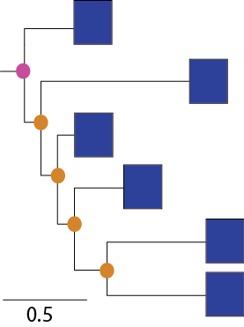
Terminology

Slide 11
Terminology
Tip/Taxon/Virus/Leave
-Sequenced Viruses
-we also know date and
location of isolation,
host and clinical features

Slide 12
Terminology
Tip/Taxon/Virus/Leave
-Sequenced Viruses
-we also know date and
location of isolation,
host and clinical features
Internal Node
Putative common Ancestor

Slide 13
Terminology
Tip/Taxon/Virus/Leave
-Sequenced Viruses
-we also know date and
location of isolation,
host and clinical features
Internal Node
Putative common Ancestor
Root – provides an order for sequence of events leading to observation (sequenced
virus)

Slide 14
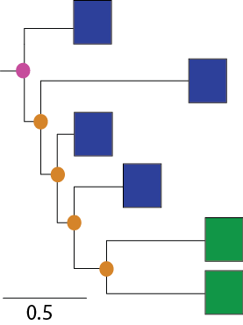
Terminology
Monophyletic group
(Clade) = all members share common
ancestry

Slide 15
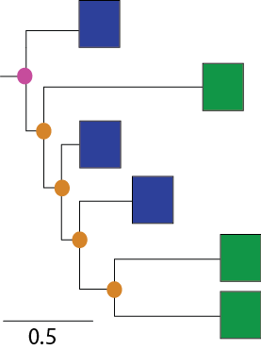
Terminology
Paraphyletic = a group of organisms descended from a common ancestor, but not including all the descendant groups

Slide 16
Tree topology
is the product of historical processes

Slide 17
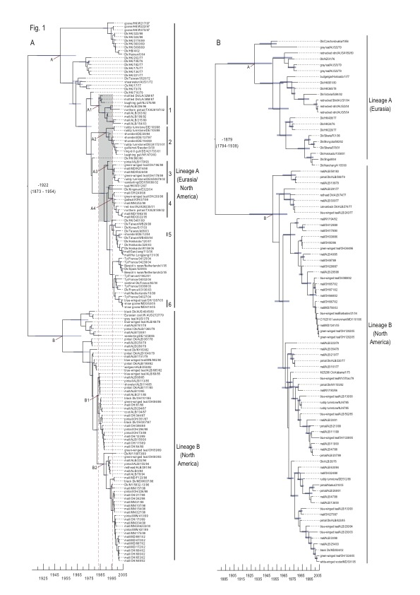
Tree topology
is the product of historical processes
Phylogenetic clustering is due to geographical and ecological separation of wild bird hosts in North America and Eurasia

Slide 18
Phylodynamics
Ecological inference includes co-estimation of migration and phylogeny, host switch and population bottlenecks.
(Discrete and continuous models of spatial diffusion - Lemey et al 2009, 2010)

Slide 19
Phylodynamics
The rapid evolution of many pathogens, particularly RNA viruses, means that their evolution and ecology occur on the same timescale, and therefore must be studied jointly to be fully understood.
All observations (i.e. viruses isolated during an outbreak) are related by common descent
Evolution is bifurcating (Tree-like)
small genetic distances = closely related

Slide 20
Phylodynamics
Epidemiological inference includes estimation of population structure, transmission rates (R₀), epidemic patterns, source populations (Drummond et al 2005;Hedge et al, 2013).

Slide 21
Epidemic Dynamics

Slide 22
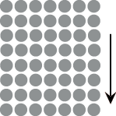
Population size and coalescence time

Slide 23
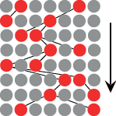
Small Population

Slide 24
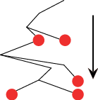
Small Population

Slide 25
Large Population

Slide 26
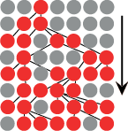
Large Population

Slide 27
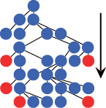
Large Population

Slide 28
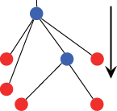
Large Population

Slide 29
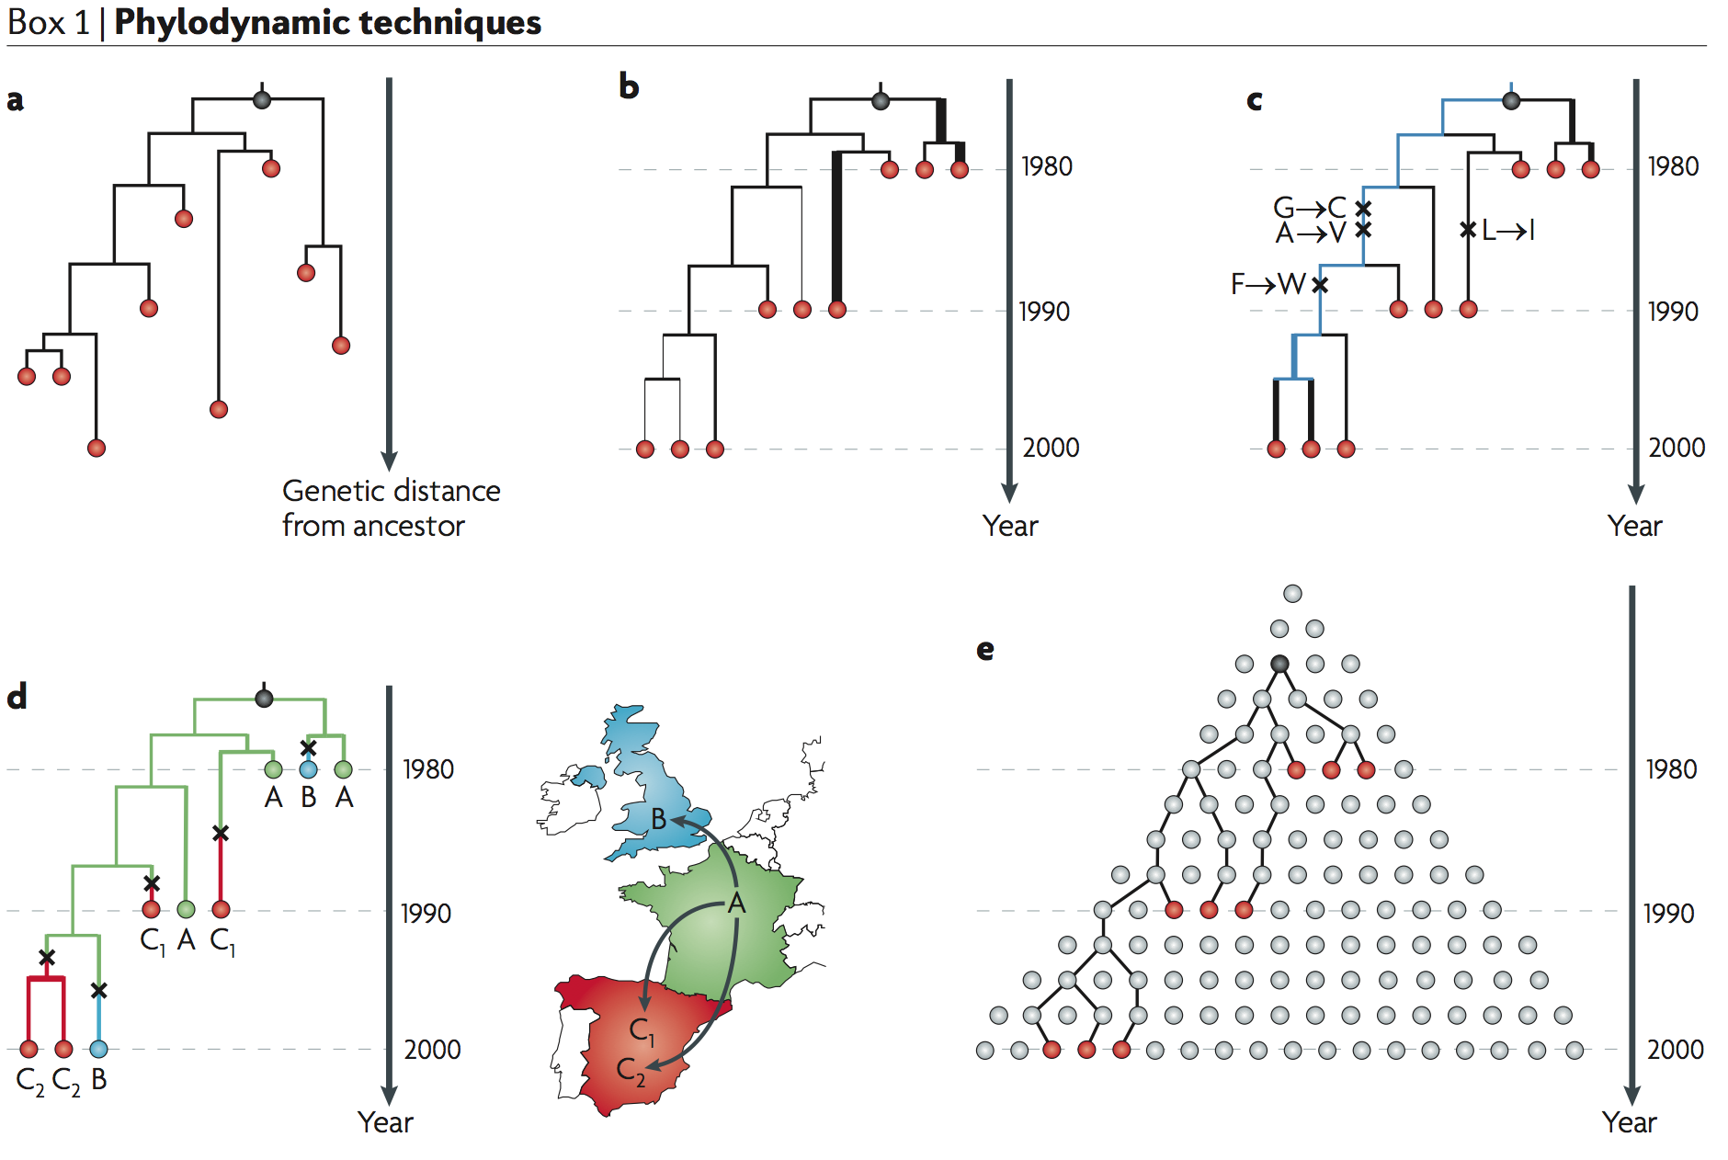
Pybus and Rambaut, Nature Reviews Genetics, 2009

Slide 30
Spatial Epidemiology

Slide 31
Real-time disease tracking
Time and space
of ancestors

Slide 34
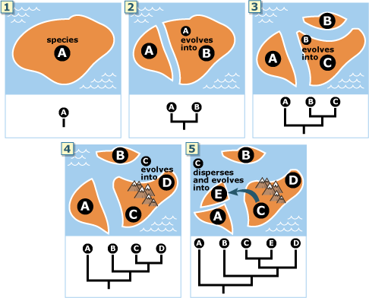
http://evolution.berkeley.edu/evolibrary/news/091001_madagascar

Slide 35
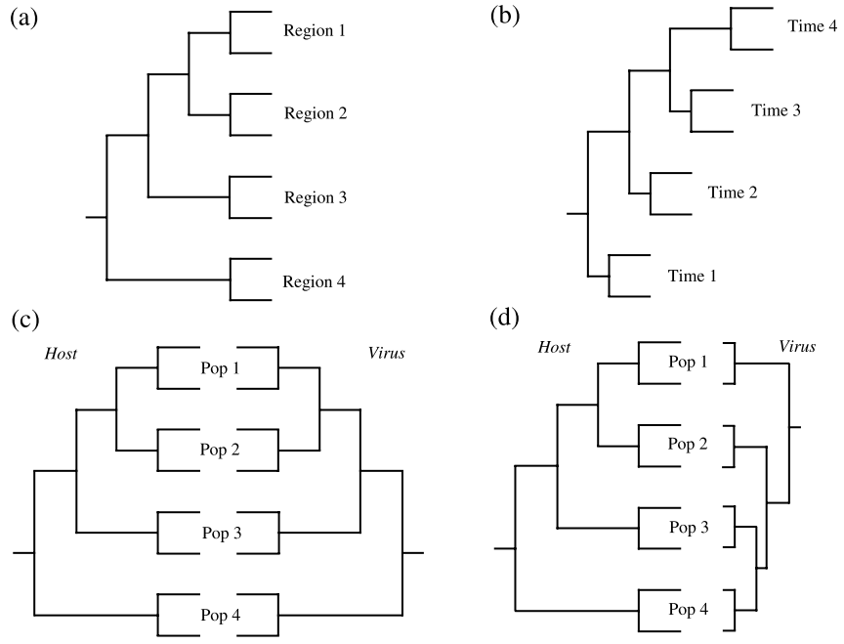
Phylogeography of Infectious Disease
Holmes (2004). The Phylogeography of human viruses. Molecular Ecology

Slide 36
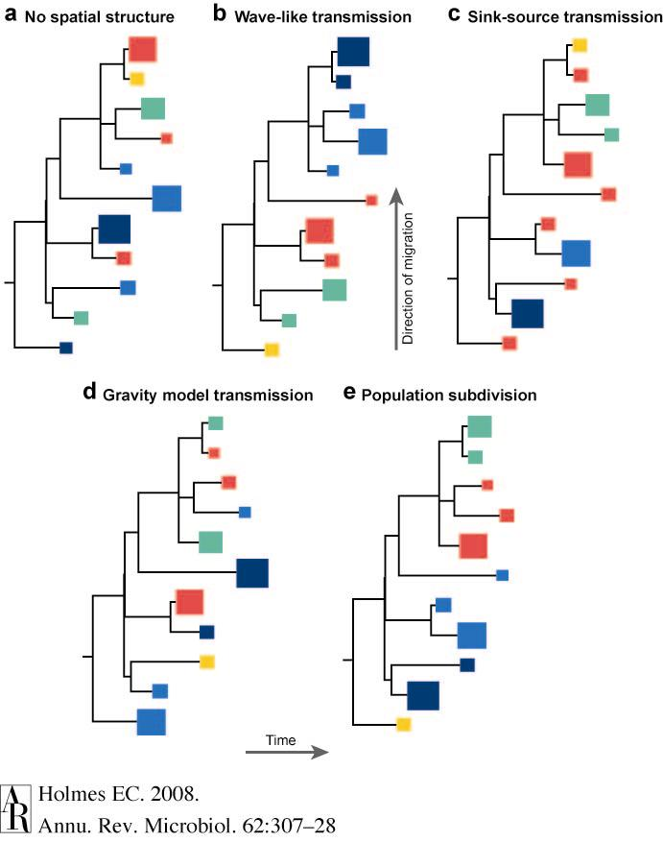
Annual Reviews

Slide 38
Where did the Indonesian and Vietnamese outbreaks come from?

Slide 39
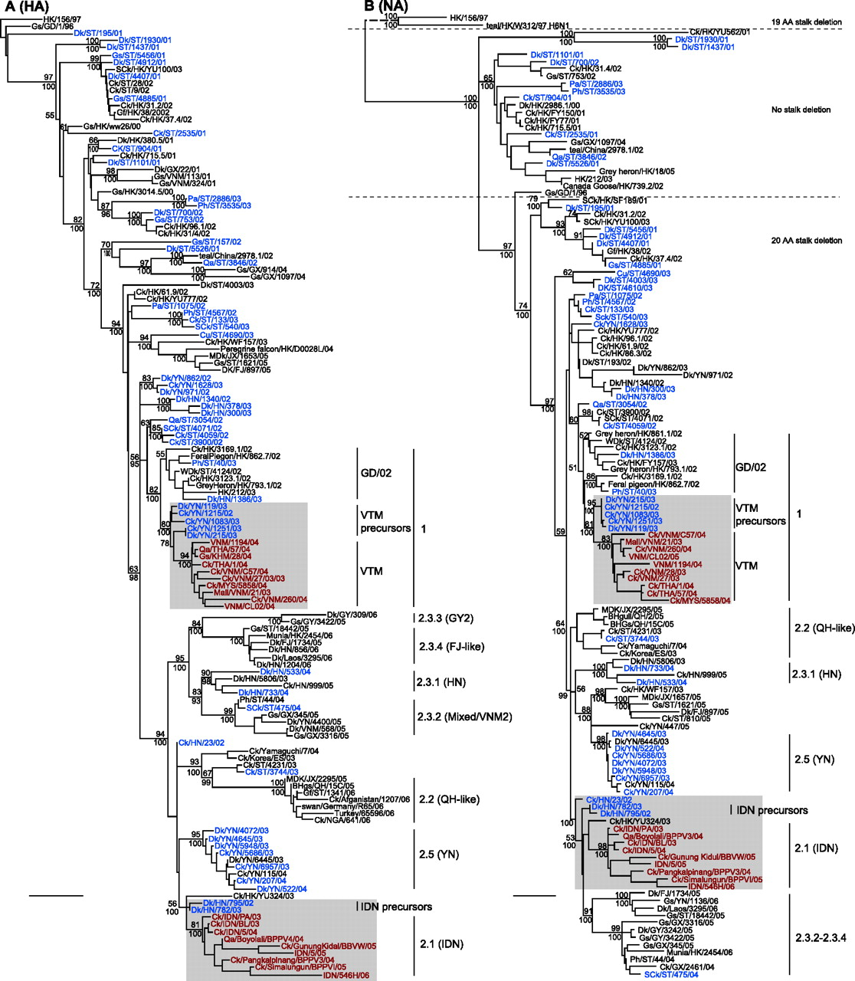

Phylogenetic relationships of the HA (A) and NA (B) genes of representative influenza A viruses.
J. Wang et al. J. Virol. 2008; doi:10.1128/JVI.02468-07
Notes:
Phylogenetic relationships of the HA (A) and NA (B) genes of representative influenza A viruses. The numbers above and below the branch nodes indicate neighbor-joining bootstrap values of ≥50% and Bayesian posterior probabilities of >95, respectively. Analyses were based on nucleotides 22 to 1,032 of the HA gene and nucleotides 1 to 1,090 of the NA gene. The HA and NA gene trees were rooted to duck/Hokkaido/51/96 and chicken/Scotland/59, respectively. Colors indicate viruses isolated from southern China (blue), Vietnam (red), and Indonesia (red). Scale bar, 0.01 nucleotide substitutions per site. Abbreviations: BHGs, bar-headed goose; BHgull, brown-headed gull; Ck, chicken; Cu, chukkar; Dk, duck; FJ, Fujian; Gf, Guinea fowl; Gs, goose; GD, Guangdong; GX, Guangxi; GY, Guiyang; HK, Hong Kong; HN, Hunan; IDN, Indonesia; JX, Jiangxi; Mall, mallard; MDk, migratory duck; MYS, Malaysia; NGA, Nigeria; Pa, partridge; Ph, pheasant; Qa, quail; QH, Qinghai; SCk, silky chicken; ST, Shantou; THA, Thailand; VNM, Vietnam; WDk, wild duck; YN, Yunnan.

Slide 40
Phylogenetic relationships of the HA (A) and NA (B) genes of representative influenza A viruses.
J. Wang et al. J. Virol. 2008; doi:10.1128/JVI.02468-07
Notes:
Phylogenetic relationships of the HA (A) and NA (B) genes of representative influenza A viruses. The numbers above and below the branch nodes indicate neighbor-joining bootstrap values of ≥50% and Bayesian posterior probabilities of >95, respectively. Analyses were based on nucleotides 22 to 1,032 of the HA gene and nucleotides 1 to 1,090 of the NA gene. The HA and NA gene trees were rooted to duck/Hokkaido/51/96 and chicken/Scotland/59, respectively. Colors indicate viruses isolated from southern China (blue), Vietnam (red), and Indonesia (red). Scale bar, 0.01 nucleotide substitutions per site. Abbreviations: BHGs, bar-headed goose; BHgull, brown-headed gull; Ck, chicken; Cu, chukkar; Dk, duck; FJ, Fujian; Gf, Guinea fowl; Gs, goose; GD, Guangdong; GX, Guangxi; GY, Guiyang; HK, Hong Kong; HN, Hunan; IDN, Indonesia; JX, Jiangxi; Mall, mallard; MDk, migratory duck; MYS, Malaysia; NGA, Nigeria; Pa, partridge; Ph, pheasant; Qa, quail; QH, Qinghai; SCk, silky chicken; ST, Shantou; THA, Thailand; VNM, Vietnam; WDk, wild duck; YN, Yunnan.

Slide 42
Phylodynamics
Evolutionary analysis methods can be applied to the investigation of viral dynamics at different organizational scales, from global studies of pathogen dissemination among continents, to the dynamics of infection within the tissues of individual infected hosts.

Slide 43
Phylodynamics
Viral genomes are an important and independent source of information about epidemiological processes, thereby supporting and corroborating epidemiological results obtained using standard surveillance methods.

Slide 44
Spatial Epidemiology
the description and analysis of geographic variations in disease with respect to demographic, environmental, behavioral, socioeconomic, genetic, and infectious risk factors.
disease mapping, geographic correlation studies, disease clusters, and clustering

Slide 45
Infectious Disease Spatial Epi
Analysis of integrated location of isolation and molecular data allows for spatial views of molecular epidemiological properties associated with outbreaks.
E.g. showing sequence variation of genes associated with disease virulence between outbreak locations.

Slide 46
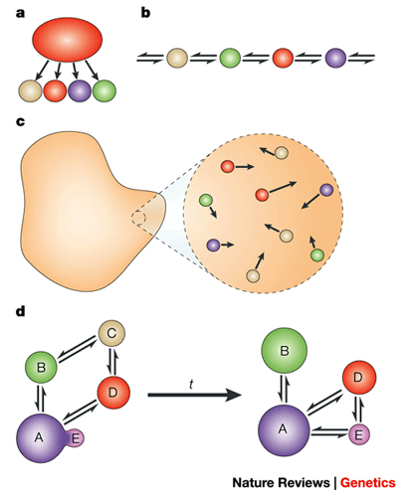
Spatial models of populations
Island model
Stepping Stone Model
Isolation by Distance Model
Meta-Population Model

Slide 47
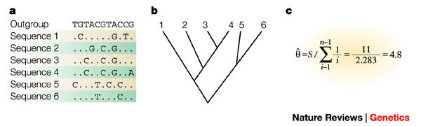
Approach
Sampled sequences
Build Tree (Phylogeographic approach)
Estimate summary statistics (Population genetic approach). E.g. estimate the population mutation rate (theta = 4Nu)

Slide 48
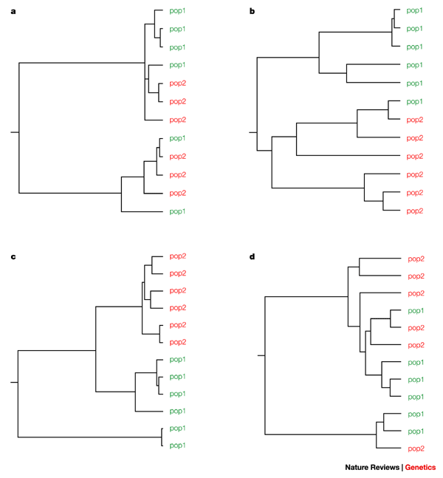

Slide 49
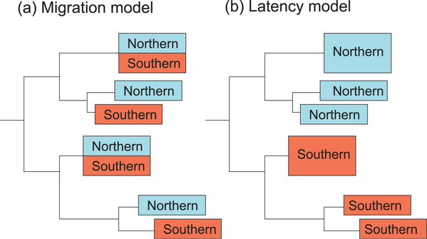
Migration dynamics of Seasonal influenza
Nelson MI et al (2007) PLoS Pathog 3(9): e131. doi:10.1371/journal.ppat.0030131

Slide 50
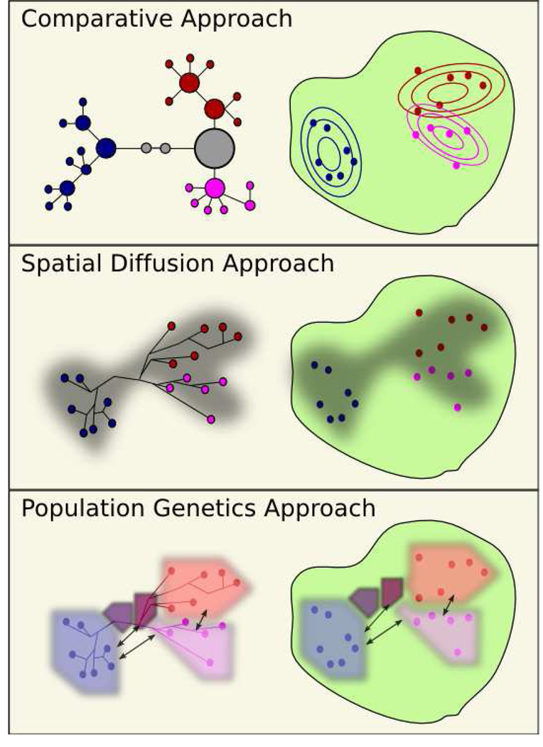
Nested Clade Phylogeographic Analysis
model-based approaches that take a probabilistic perspective on spatial diffusion
Structure coalescent
allow us to infer pop-level info from a small sample.

Slide 51
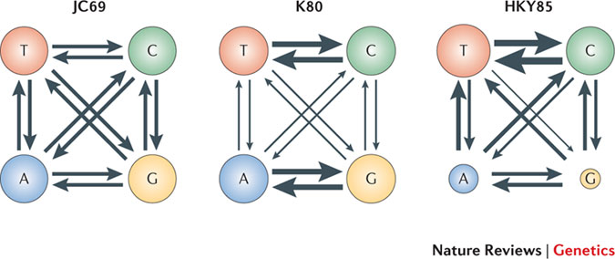
Nucleotide Substitution Models
-estimate substitution rates

Slide 52
Island GTR model
B
C
A
D
Circle size represents carrying capacity
Thickness of arrows represents dispersal rate

Slide 53
Model
distribution
DNA data 1
T₁
GTR₁
μ₁
m₁
DNA data 2
T₂
GTR₂
μ₂
m₂
IM
IM – island model
μ_{i} – mutation rate
m_{i} - dispersal rate
DNA data 3
T₃
GTR₃
μ₃
m₃

Slide 54
Canary Islands – GTR model
D
B
C
A
Western
Central
Eastern
Mainland

Slide 55
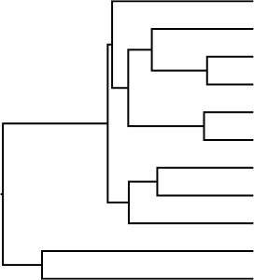
Phylogenetic diffusion models
Discrete Model:
 | A | B | C | D
A | . | πBi | πCj | πDk
B | πAi | . | πCl | πDm
C | πAj | πBl | . | πDn
D | πAk | πBm | πCn | .
CTMC
A
i
B
C
k
l
A
j
m
A
B
C
n
D
D
D
B
B
C
A
C
Courtesy of Philippe Lemey

Slide 56
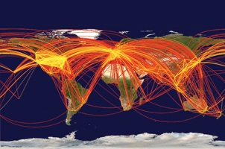
Human transport network and disease spread
Rapid worldwide spread of ID (SARS, H1N1)
Phylogeography diffusion models allow us to estimate dispersal and vicariance of viral populations

Slide 57
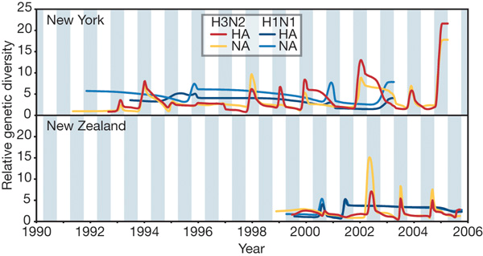
Rambaut et al, Nature 2008
Temporally offset epidemic peaks – strong bottlenecks
Continual—but largely unidirectional—gene flow from a common source population provides the viruses that ignite each epidemic in populations of the Northern and Southern Hemispheres

Slide 58
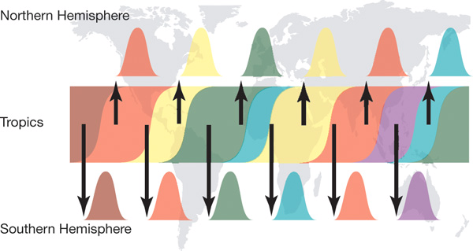
Rambaut et al, Nature 2008

Slide 59
Rambaut et al, Nature 2008
Analyzed the seasonal dynamics in regions with temporally offset epidemics.
Analysis of temperate data only suggest these regions are not seeding each other.
But no data from tropical regions was analyzed

Slide 60
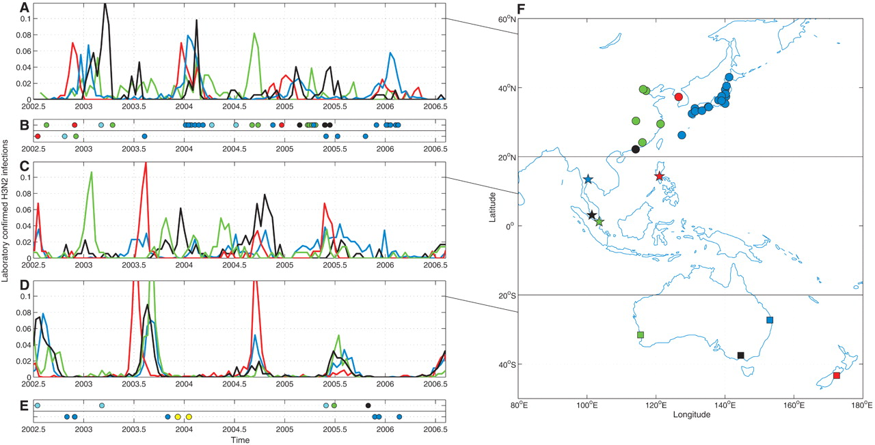
Russell et al, Science 2008
C A Russell et al. Science 2008;320:340-346
Published by AAAS
Notes:
Synchrony of epidemics in east Asia and the South Pacific. (A) Epidemics in east Asia. The y axis shows laboratory-confirmed H3N2 infections per 2 weeks as a proportion of the total number of laboratory-confirmed H3N2 infections over the study period in each location. (B) Strains on the trunk of the phylogenetic tree are of particular evolutionary importance in testing for virus migration among countries. In (B) and (E), there is a circle for every strain on the trunk of the phylogenetic tree (figs. S3A and S4). The purpose is to show where the trunk strains were isolated [top row color code from (A), bottom row from (C)] and when they were isolated, to assess the epidemiological activity at the time of isolation. Cyan circles represent E-SE Asian strains but in locations not shown in (F). (C) Same as (A) but for tropical Southeast Asia. (D) Same as (A) but for Australia and New Zealand. (E) Same as (B), but the top row are Oceanian strains [cyan circles represent strains from cities in Australia not shown in (F)], and the bottom row are strains from North America (blue) and Russia and Ukraine (yellow). (F) Geographic setting for (A) to (E).

Slide 61
If the ‘trunk’ of the phylogenetic trees is located in a single location then that location may be a likely source.
Russell et al evaluated this by calculating the genetic distance from the trunk
Found most trunk isolates were located in SEA or East Asia

Slide 62
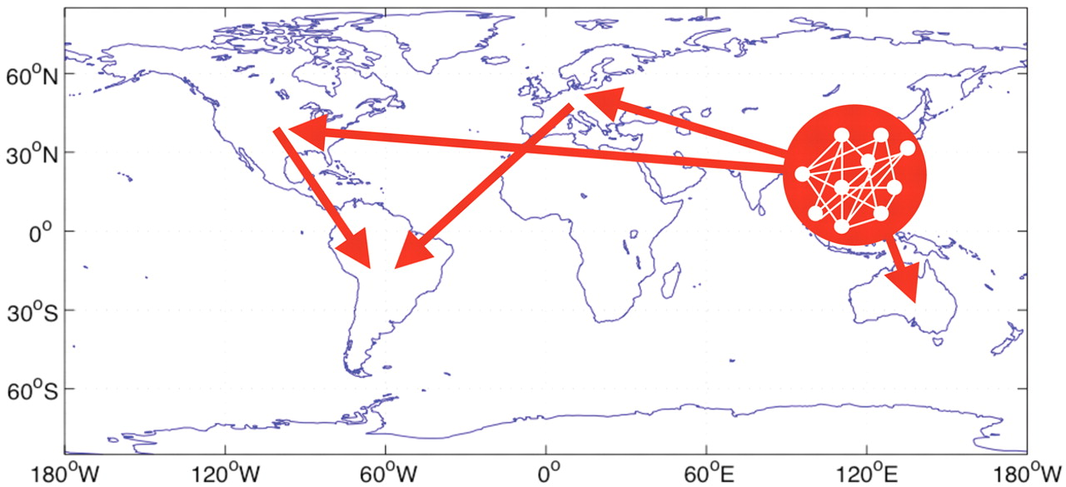
Russell et al, Science 2008
C A Russell et al. Science 2008;320:340-346
Published by AAAS
Notes:
Schematic of the dominant seeding hierarchy of seasonal influenza A (H3N2) viruses. The structure of the network within E-SE Asia is unknown.

Slide 63
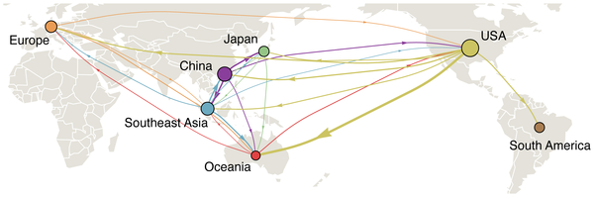

Figure 1. Global migration patterns of influenza A (H3N2) estimated from sequence data between 2002–2008.
Bedford T, Cobey S, Beerli P, Pascual M (2010) Global Migration Dynamics Underlie Evolution and Persistence of Human Influenza A (H3N2). PLoS Pathog 6(5): e1000918. doi:10.1371/journal.ppat.1000918
http://www.plospathogens.org/article/info:doi/10.1371/journal.ppat.1000918

Slide 64
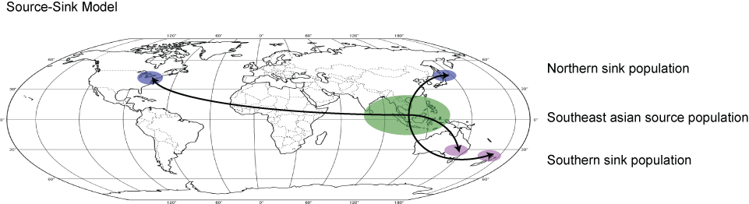
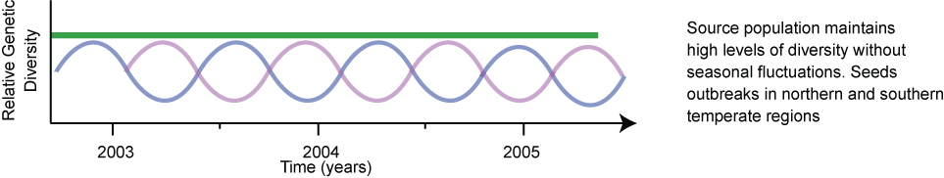
Evolutionary dynamics of H3N2 seasonal influenza
What tools do we have?

Slide 65
Evolutionary dynamics of H3N2 seasonal influenza
Assumptions
We assume that the strength of natural selection, virus mutation rates and generation times are broadly similar among all human populations, regardless of geographic location, such that any differences observed between regions likely represent differences in viral population size.

Slide 66
Evolutionary dynamics of H3N2 seasonal influenza

Slide 67
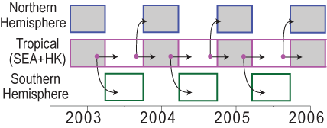
Evolutionary dynamics of H3N2 seasonal influenza
Bayesian Phylogeographic analysis of global migrational dynamics
Assess persistence in SEA and HK through space and time
Non-reversible model (try to incorporates seasonality)

Slide 68
Phylogeography – transition between discrete states
Location/Season were our discrete characters. E.g. isolates from New York between Oct 2002 and March 2003 were assigned the discrete character NY2003.
Influenza sequences have a very strong time signature that discourages time travel (i.e. viruses from NY2006 seeds NY2003 outbreak)

Slide 69
Phylogeography – transition between discrete states
Non-reversible model: therefore direction of viral migration can be assessed
Rates of migration in to a location independent of rates out
Statistical framework

Slide 70
Phylogeography – transition between discrete states
RESULTS
Tree trunk alternates between Japan, SEA, HK, Europe
Within a single year, all locations occupy part of the tree backbone

Slide 71
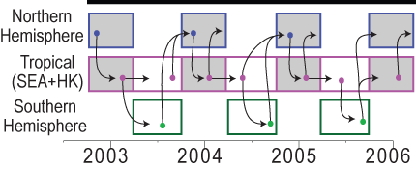
Evolutionary dynamics of H3N2 seasonal influenza

Slide 72
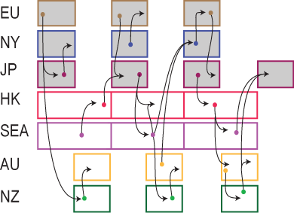
Evolutionary dynamics of H3N2 seasonal influenza

Slide 73
Phylogeography – transition between discrete states
Southern hemisphere epidemics may directly seed epidemics in Northern hemisphere
Seasonality in North and South is a strongly informative prior
Lack of seasonality in SEA and HK may be artificial (discrete character assignment)

Slide 74
Phylogeography – transition between discrete states
No model supports persistence in SEA or HK
Source-Sink Model for seasonal influenza is not supported

